Slide 1
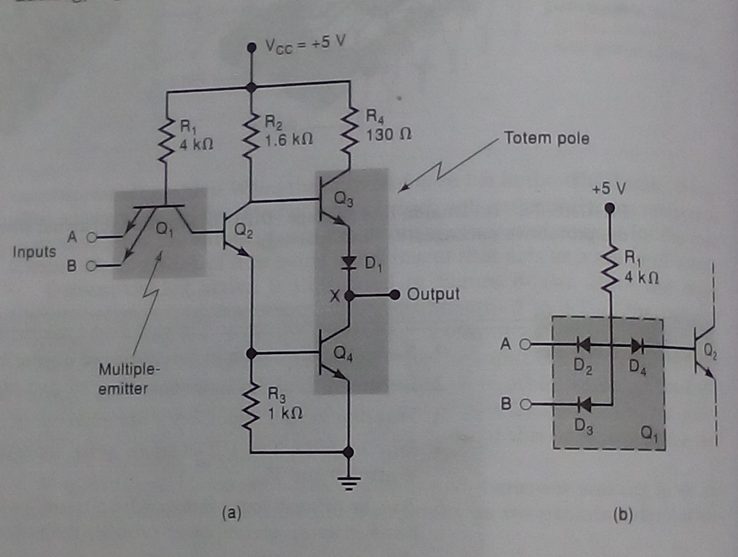
Lecture-12 (a)Basic TTL NAND gate; (b)diode equivalent for Q1

Slide 2
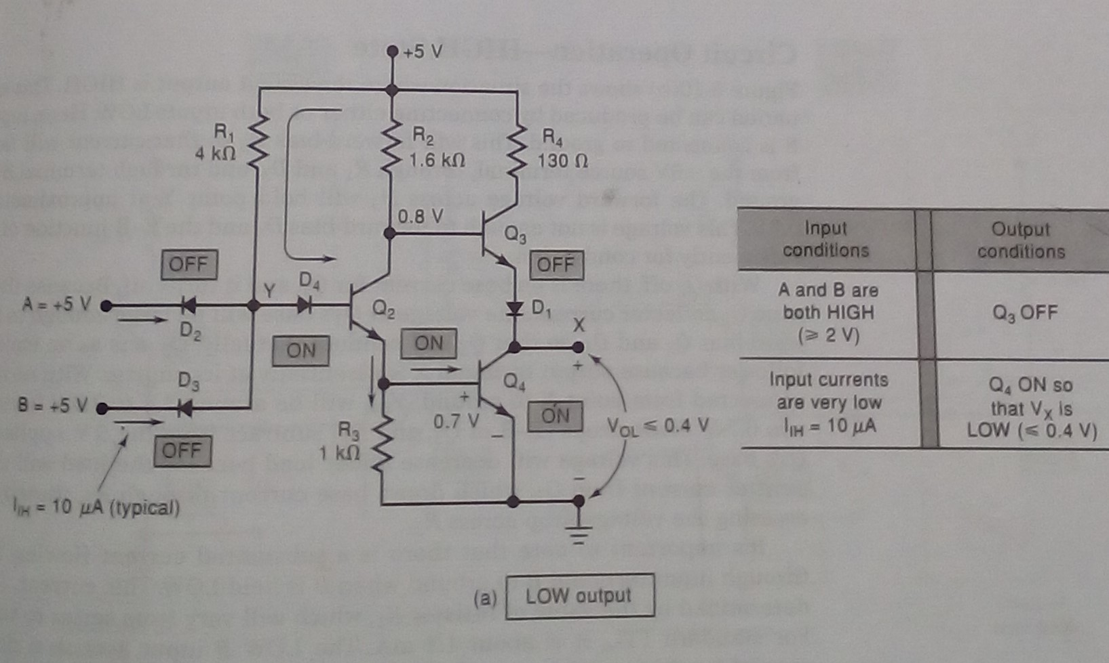
TTL NAND gate in its Low output

Slide 3
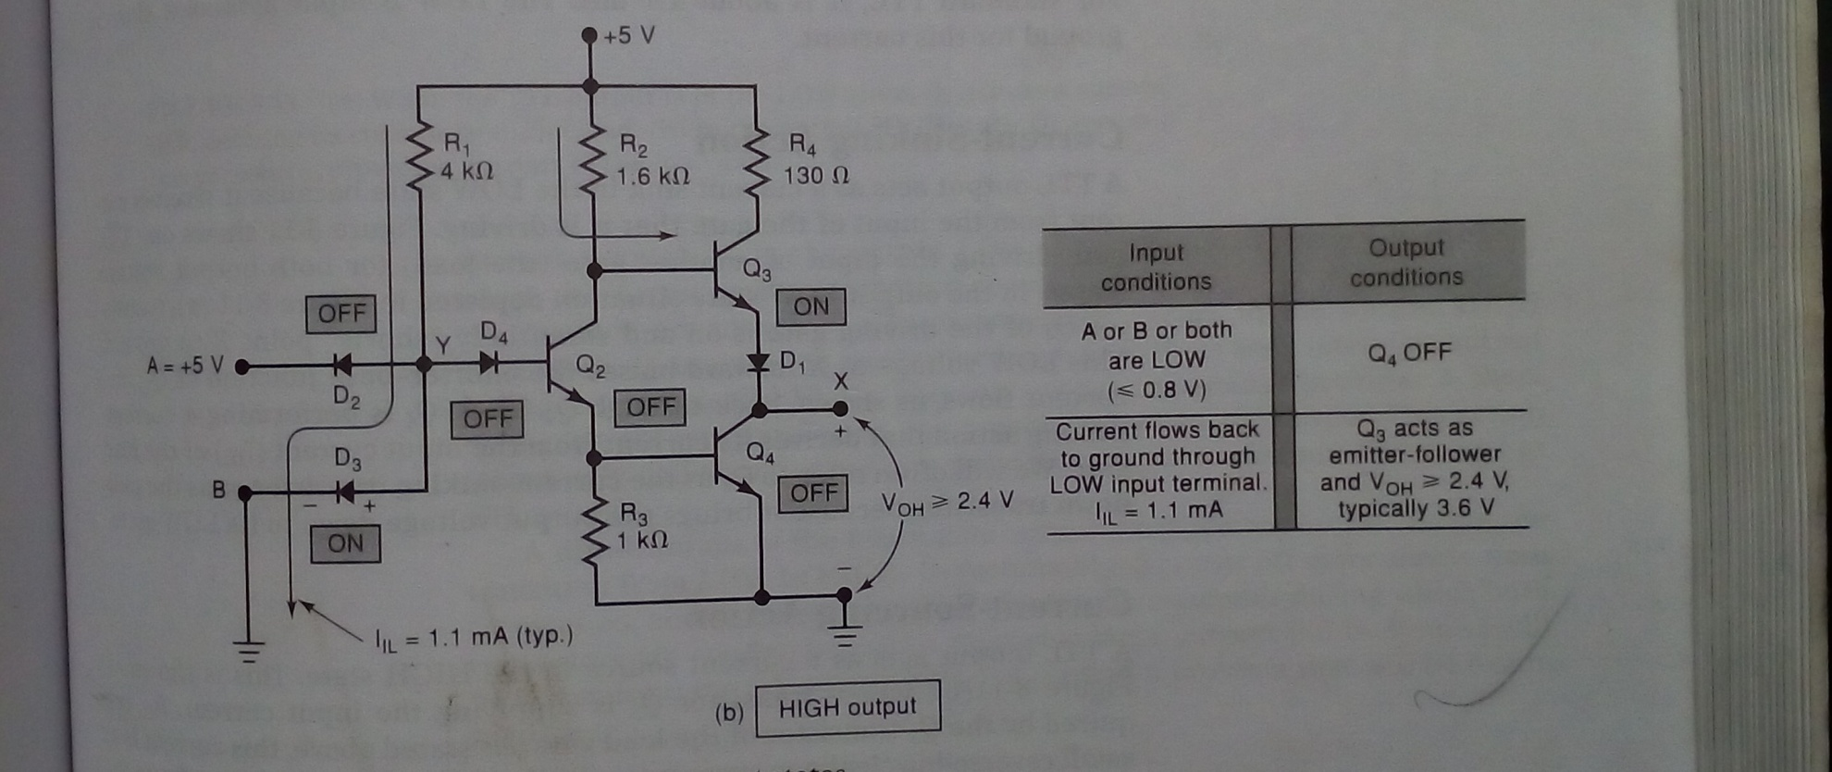
TTL NAND gate in its High output

